Slide 1

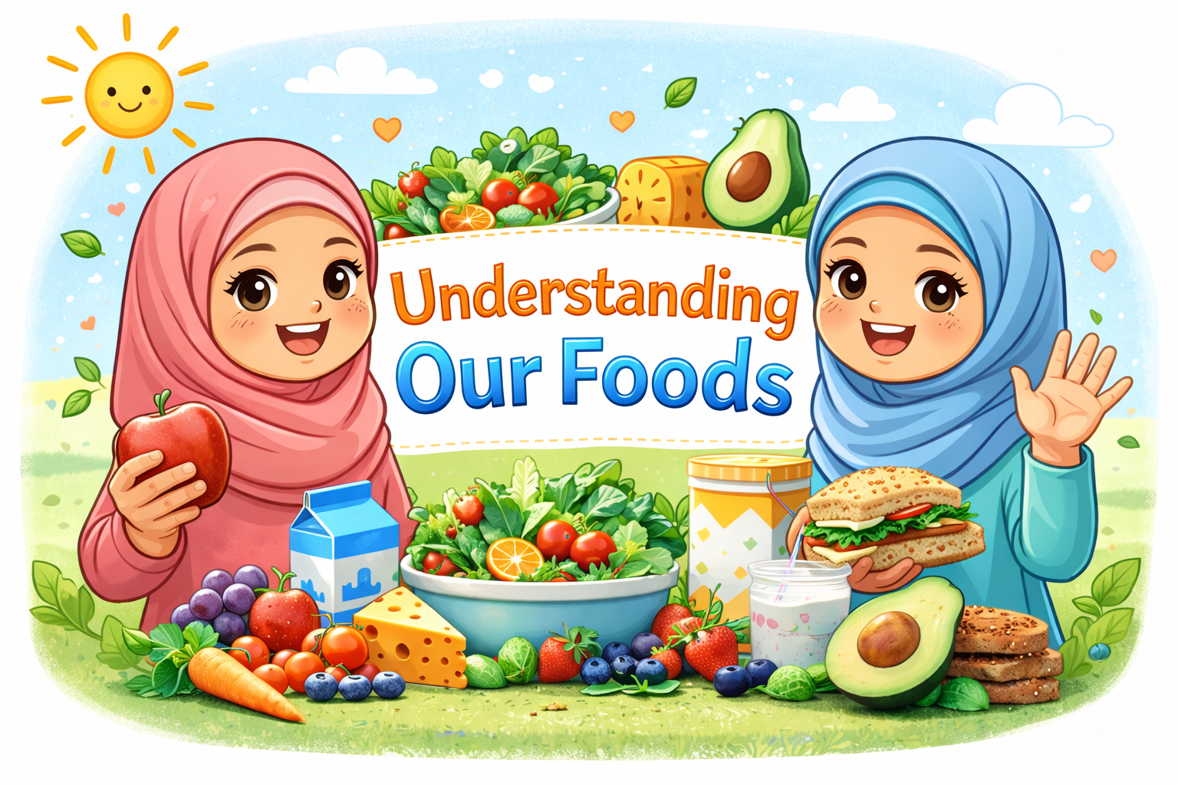

Slide 2

Allah says in the Holy Quran:
‘O ye men! eat of what is lawful and good in the earth; and follow not the footsteps of Satan; surely, he is to you an open enemy.’ (2:169)
This means that what we eat doesn’t just affect our body — it also affects our character and our spirituality.
If we eat foods that are not allowed or not good for us, it can slowly weaken our sense of right and wrong and can also make it harder for us to grow spiritually and stay close to Allah.

Slide 3
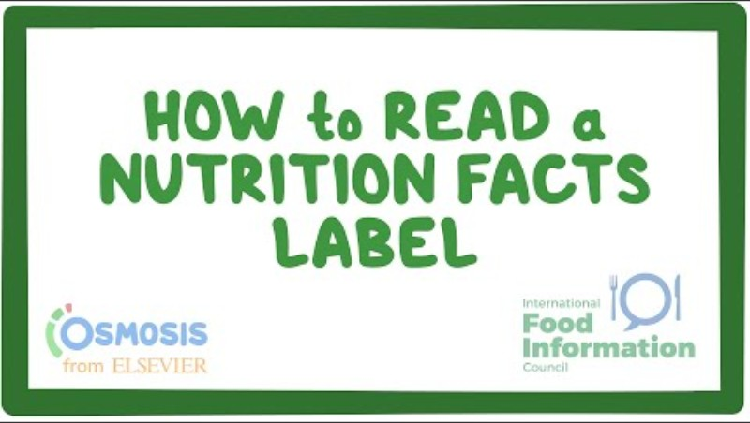
Do you know your foods?

Slide 4
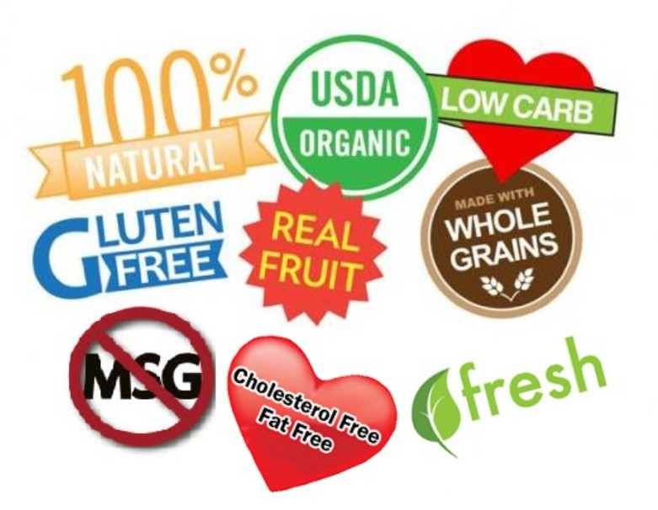
Why is it important to understand food labels?
Many foods are marketed
in misleading ways that
can confuse consumers.
Let’s explore some examples of misleading advertisements →

Slide 5
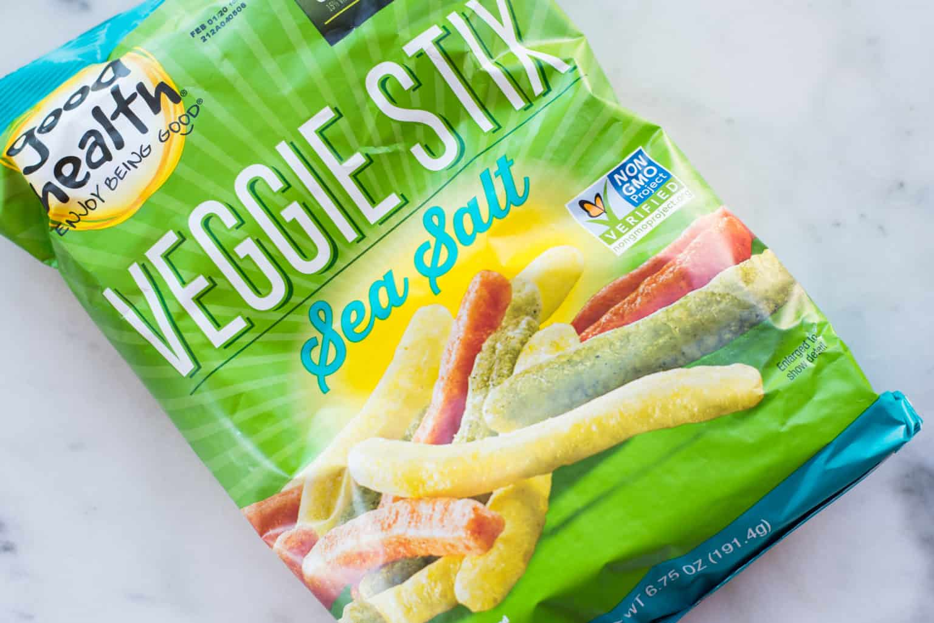
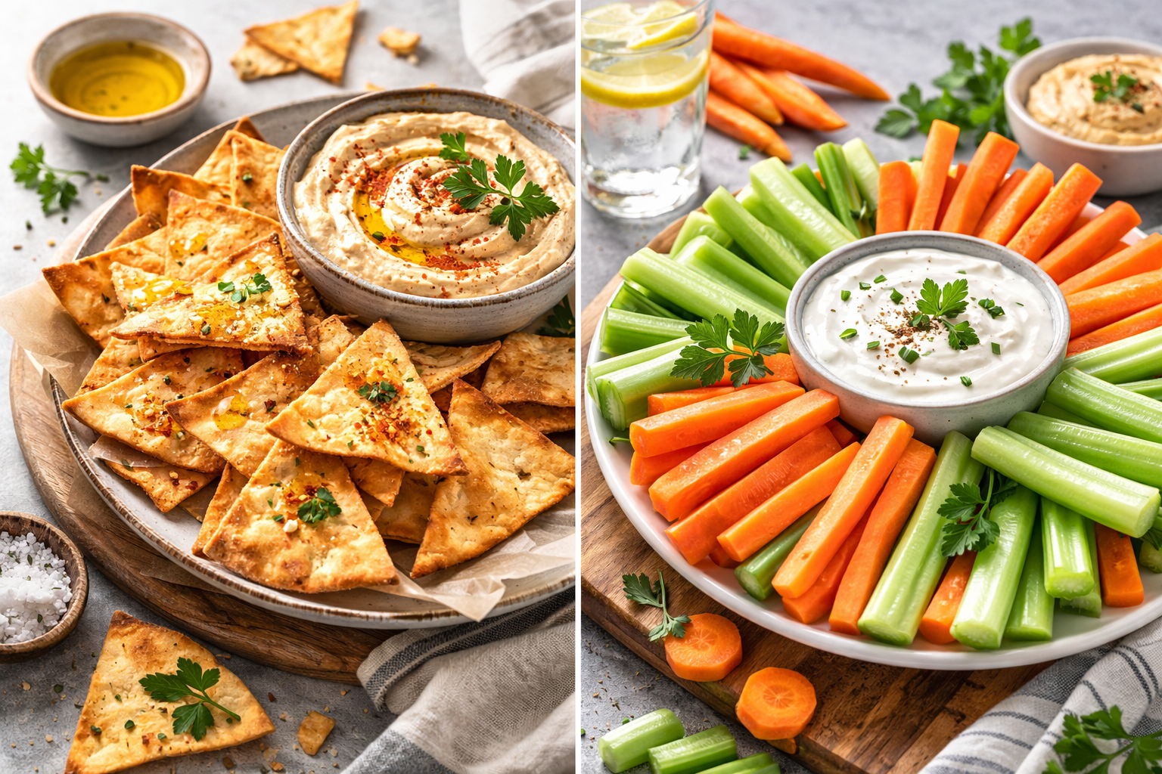
VEGGIE CHIPS
Chips made from “vegetables”.
Sounds healthy, right?
When we think vegetables, we expect fiber and all kinds
of good stuff. If we take a look at the label on a bag of Veggie Chips,
we won’t find any fiber in there at all. Instead, we will find a ton
of sodium and an awful lot of starch and oil.
Alternative:
baked pita chips or fresh and crunchy carrot
and celery sticks.

Slide 6
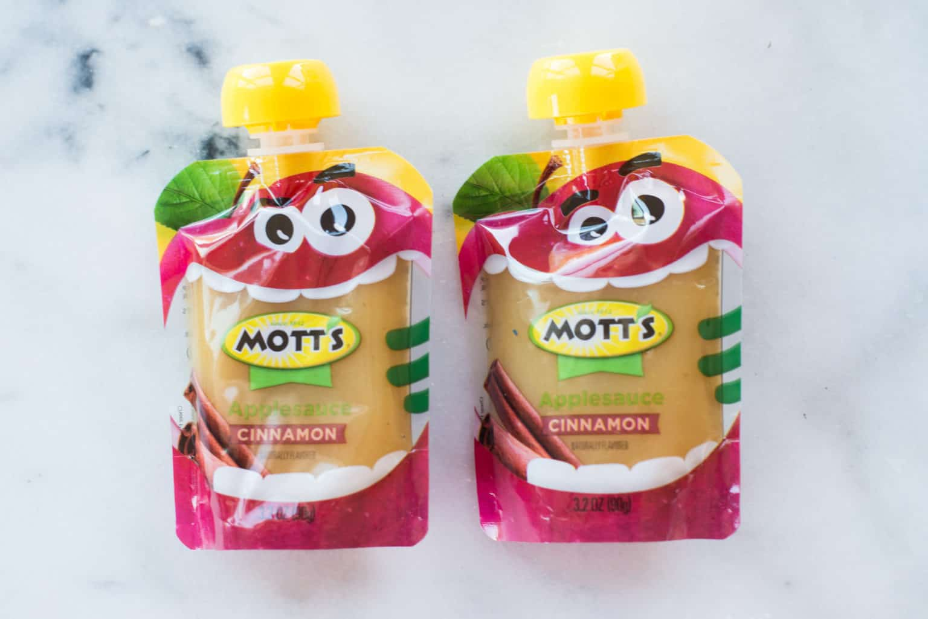
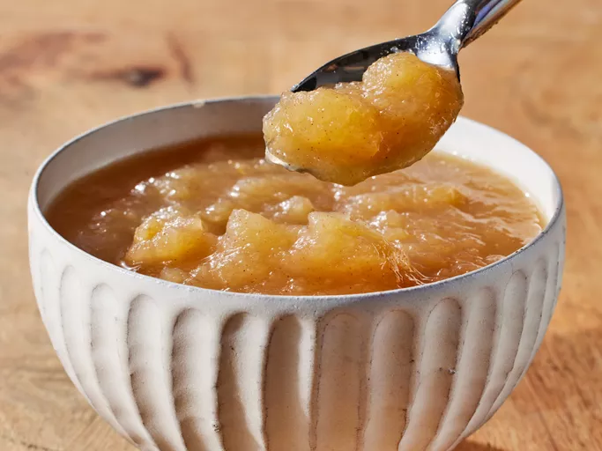
APPLESAUCE
We all think of applesauce as one of the healthiest alternatives out there for a sweet snack because it’s fruit, right?
But many packaged applesauce brands are full of added sugars like high fructose corn syrup.
Alternative:
Make your own applesauce, without the need for additional sweetening!
You can also find packaged applesauce that has no added ingredients other than apples.

Slide 7
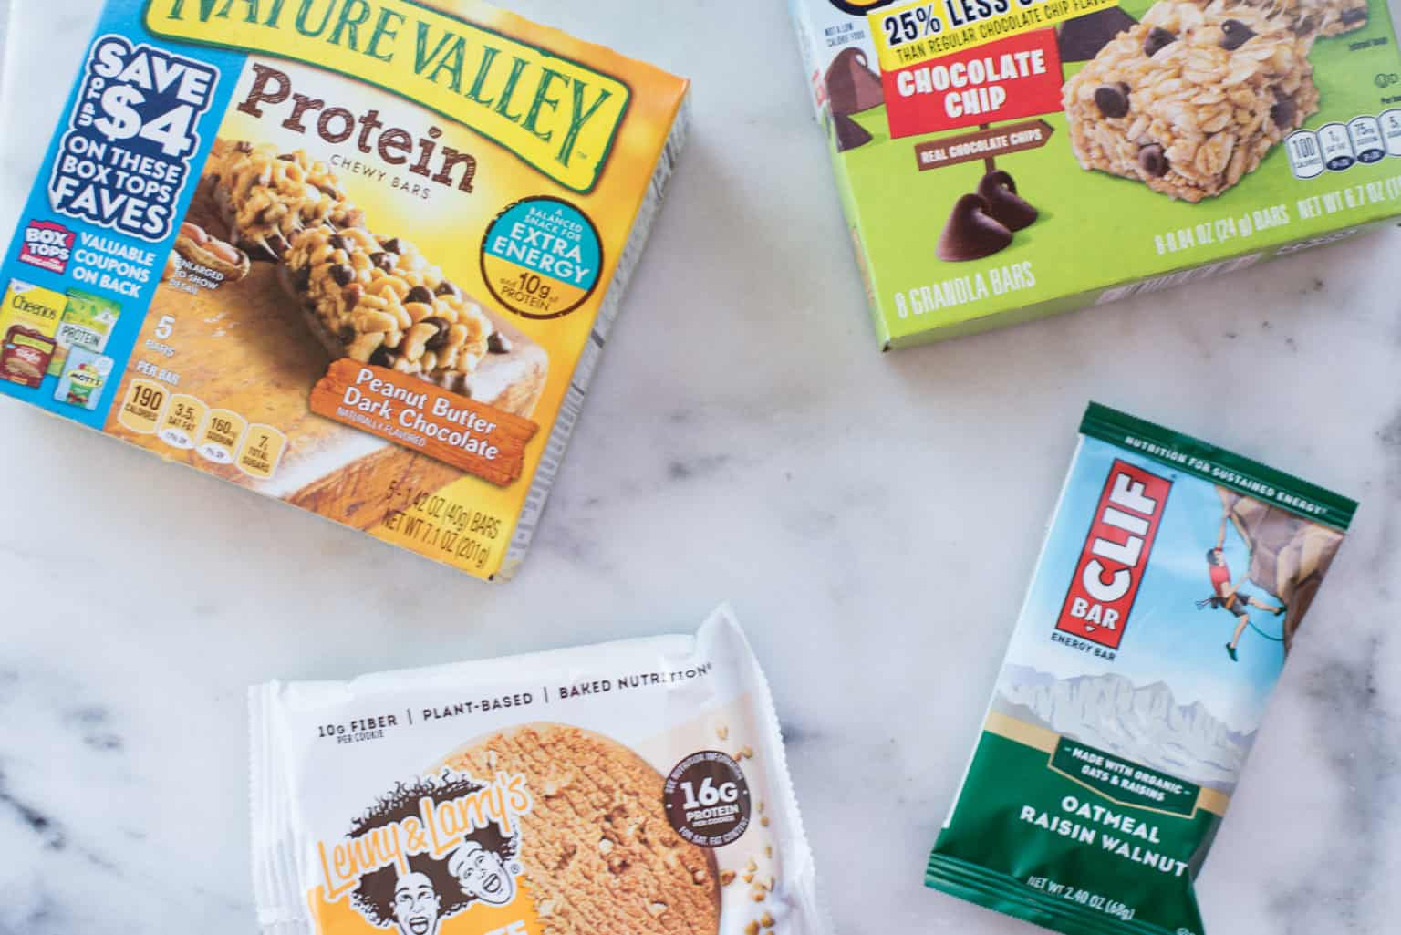
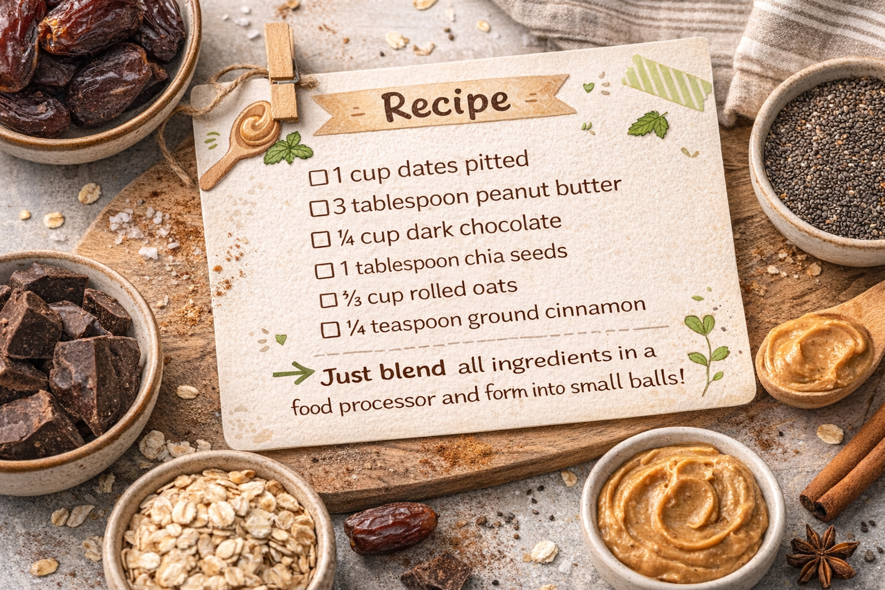
ENERGY BARS
Did you know that when we eat store-bought energy bars, the only things we are consuming are super sweet and processed brown rice syrup, cane syrup, cane sugar, and a fair amount of carbs.
Alterntive:
Make a recipe without refined ingredients;
you can find many great recipes online, like
these chocolate peanut butter energy balls
that give you a boost without an energy
Crash an hour later:

Slide 8
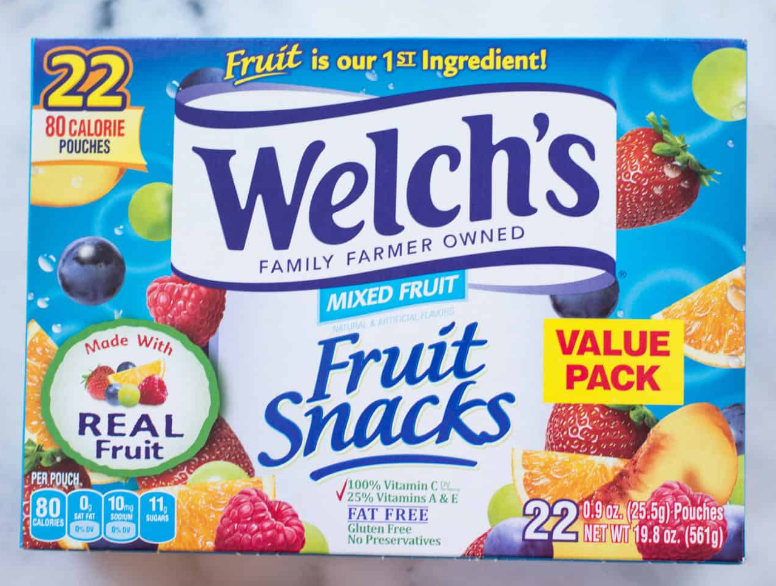
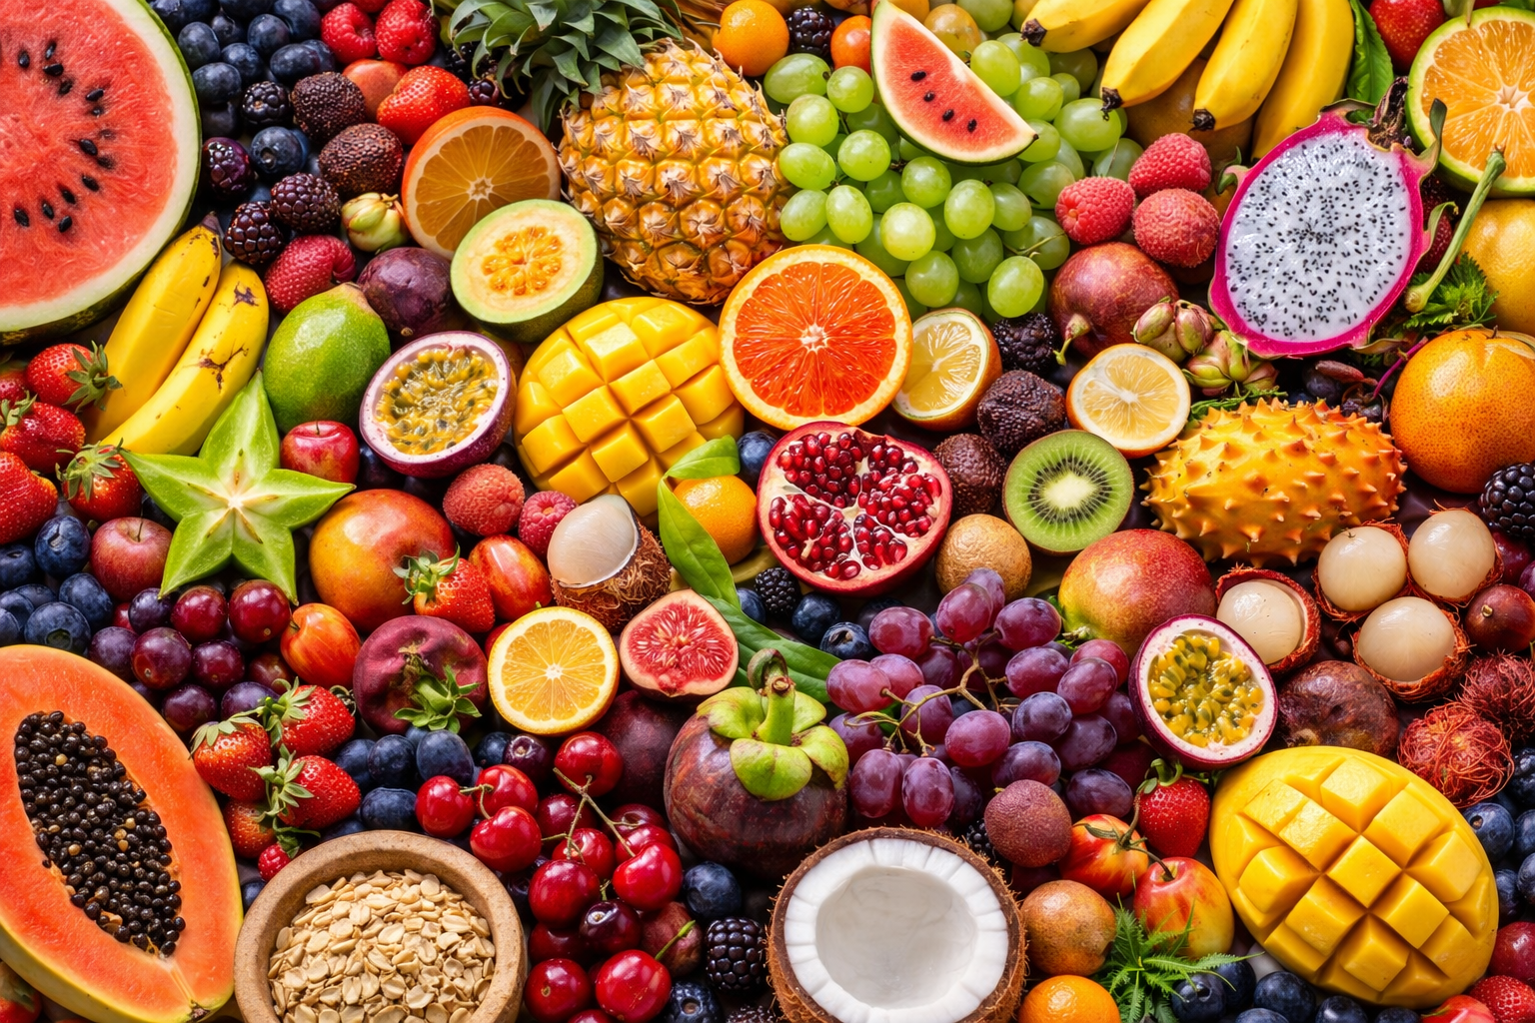
FRUIT SNACKS
Fruit snacks are marketed as a way of giving yourself a serving of fruit on the go.
But in reality, fruit snacks are just another fake “healthy” food and not much better than candy.
They contain corn syrup and sugar as their top ingredients, as well as lots of food coloring to make them pretty and attractive to kids.
Alternative:
Eat real fruit! Try different kinds; Allah has created so many different fruits, you are sure to find some that you like.

Slide 9
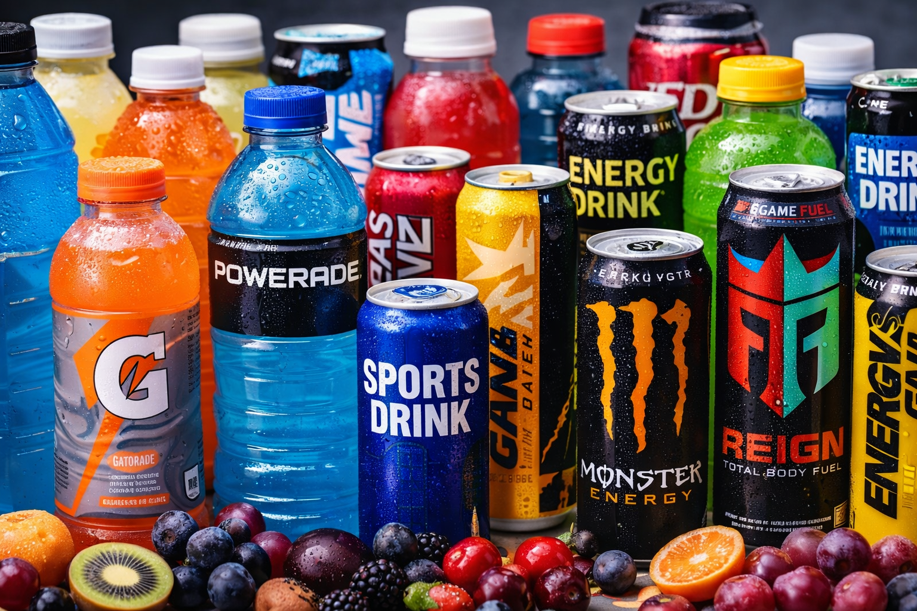
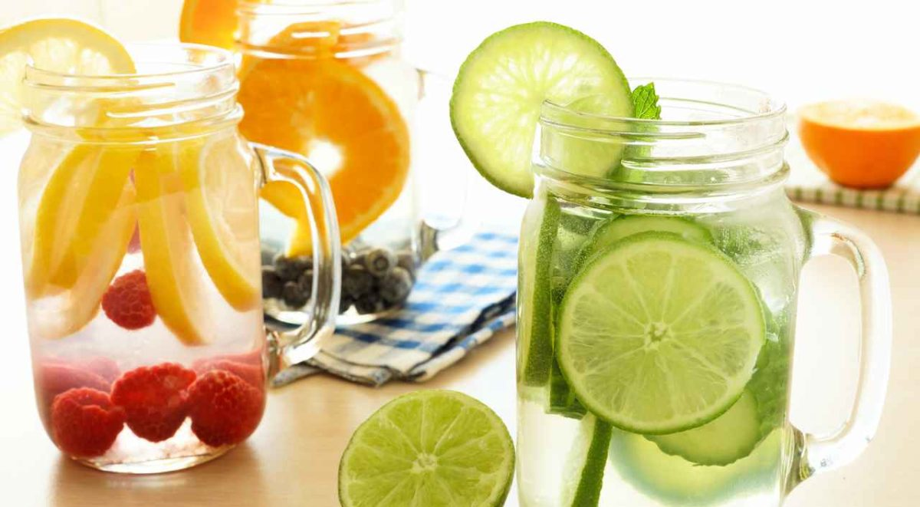
ENERGY DRINKS
Energy drinks marketed to boost our energy don’t mention the sugar, sodium, carbs, and artificial dyes that they contain, as well as the caffeine and other stimulants which are proven to be bad especially for children’s health.
Alternative:
Water is always the best choice for hydration!
You can also enhance the flavor of your water with adding lemon, lime, orange, mint, cucumber, berries etc., or replace energy drinks with coconut water.

Slide 10
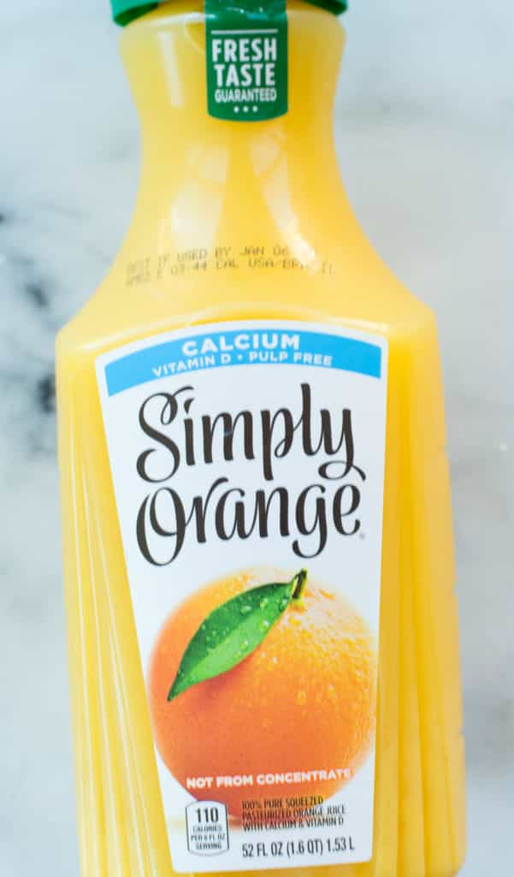
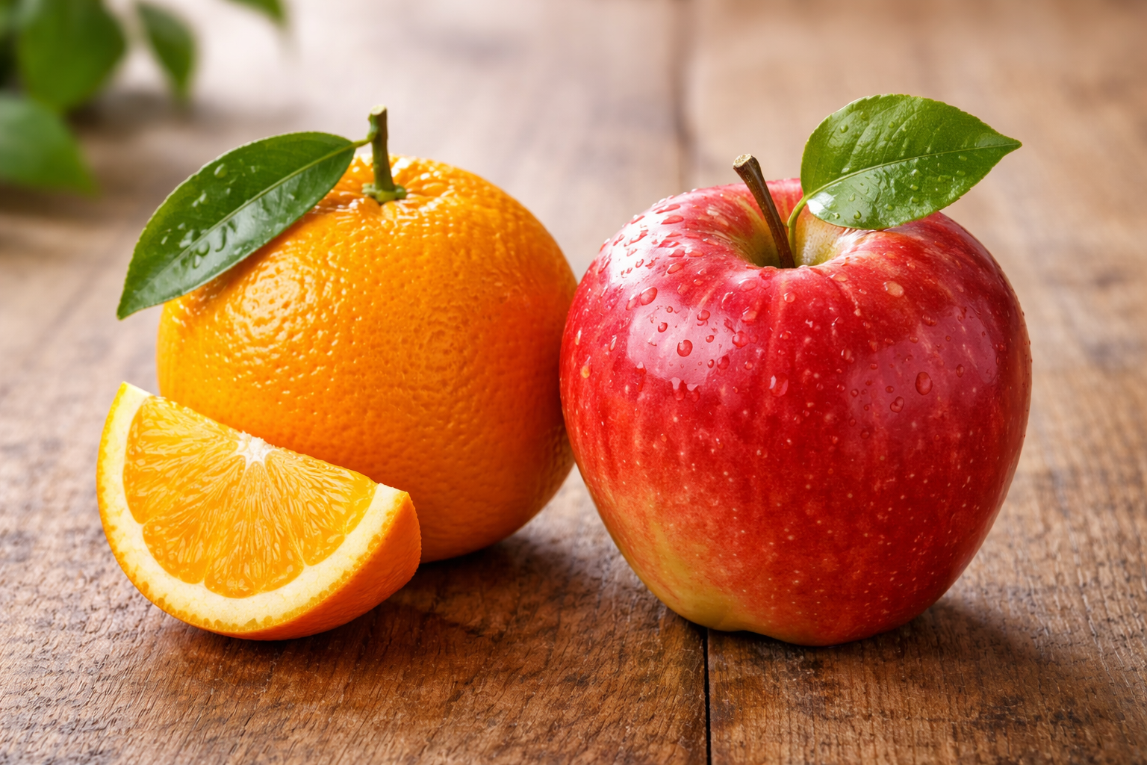
FRUIT JUICE
Juices, even those that are advertised as freshly squeezed, are loaded with tons of sugar and carbs.
There is no fiber in them (fiber is one of the biggest reasons fruits are good for us); when processed into juice, a piece of fruit changes from something good to eat into a fake “healthy” food.
Alternative:
Eat a piece of fruit like a nice juicy orange,
grapes or a crisp apple.
Pair it up with a glass of water!

Slide 11
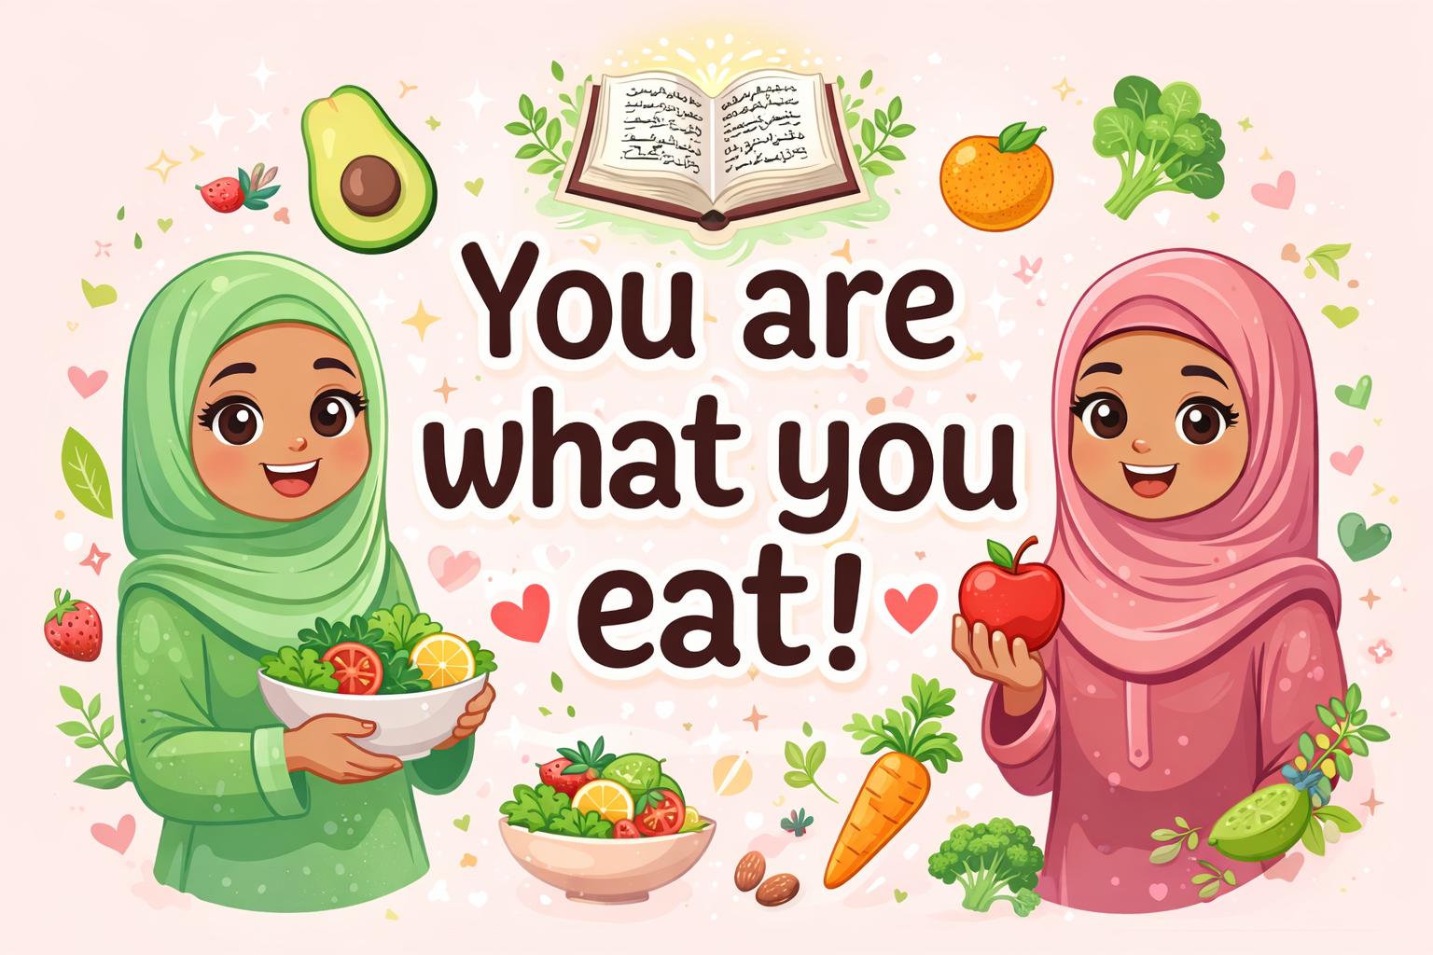
Remember:
So, choose your foods wisely.

Slide 12
References
https://alislam.org/quran/app/2:169
https://www.asweetpeachef.com/fake-healthy-foods/
https://www.seattlechildrens.org/healthy-tides/why-kids-and-teens-should-avoid-energy-drinks/
https://vitallabel.blogspot.com/2014/07/7-misleading-labels-on-food-products.html
youtube.com/watch?reload=9&v=hzwnwLgmFOQ

